Slide 1


Global Contract Research Organization (CROs)
By Prateek Kumar Yadav
07-Dec-2021

Slide 2





Executive Summary
Global Market
The top three regions with highest Contract Research Organization (CRO) market share are North America, Europe, and Asia
Market Size Estimation
North America holds the majority of Contract Research Organization (CRO) market due to the established players in the region. Phase III segment of clinical trial acquired the highest share among all phases in 2021 as it is to authenticate the evidences produced in previous preliminary trials for safety, efficacy, and combination of drugs.
Market Dynamics and Demand-Supply Analysis
Reduced cost, documentation, and expertise for RWD are the key drivers. However, shortage of skilled personnel and Tier 3 market penetration are the major challenges. Development of new multitasking software for digitalizing outsourcing is the latest trend in Contract Research Organization (CRO) market
Key Service Providers
Labcorp, IQVIA, and Pharmaceutical Product Development are the top three service providers among Contract Research Organisations (CROs)

Slide 3

Global Market

Slide 4



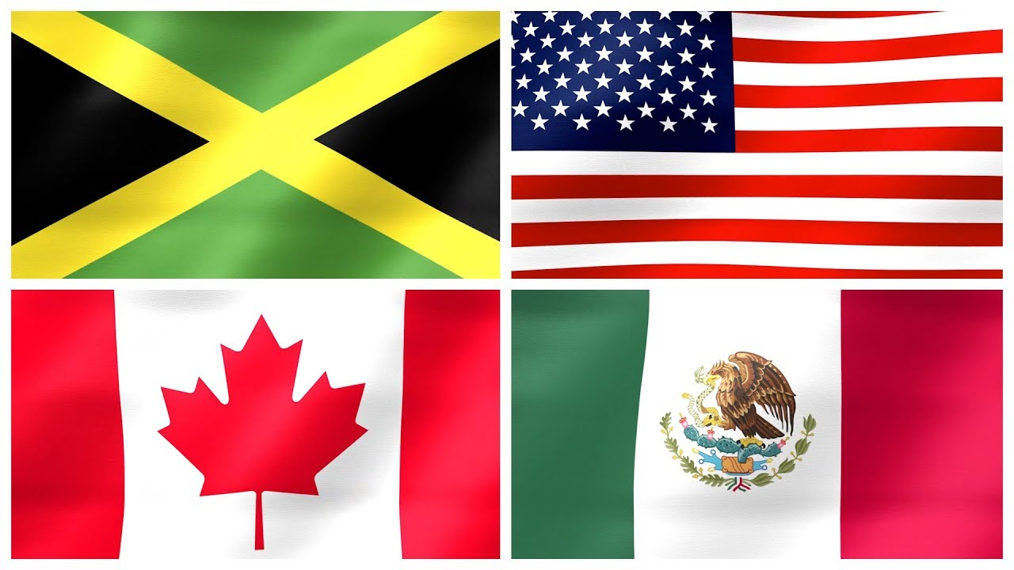
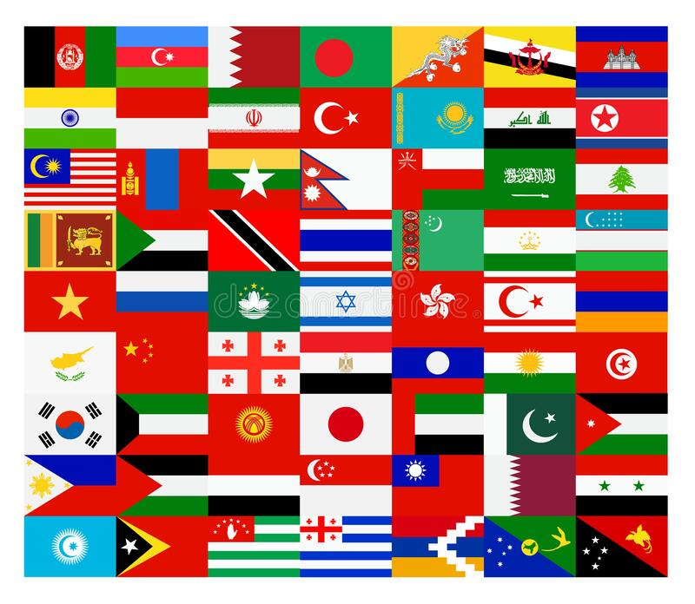
THE TOP THREE REGIONS WITH HIGHEST Contract Research Organization (CRO) MARKET SHARE ARE NORTH AMERICA, EUROPE, AND ASIA
Europe
($ 33 billion)
North America
($ 39 billion)
Asia
($ 11 billion)
Key Insights
The cost of conducting clinical trials in growing countries is approximately 40 to 60 percent lesser when compared to the developed nations. The growth of CROs in developing countries is double which is largely powered by China as it holds around 7 to 10 percent of the total global share. Within Europe, Germany is estimated to grow at approximately 4.2% CAGR
China is among the rapidly growing market followed by India, Japan, Australia, and South Korea
CRO market is estimated to acquire a CAGR of 8.54% which is mainly due to the increasing prevalence of various chronic diseases such as cancer, cardiac disease, neurological, and infectious diseases
High
Middle
Low
Source: clinicalleader, prnewswire
Notes:
https://www.clinicalleader.com/doc/an-overview-of-top-clinical-cros-0001
https://www.prnewswire.com/news-releases/global-healthcare-contract-research-organization-cro-market-2020-2027-clinical-segment-is-projected-to-account-for-44-6-billion-of-the-total-54-7-billion-market-301259641.html

Slide 5

Market Size Estimation

Slide 6

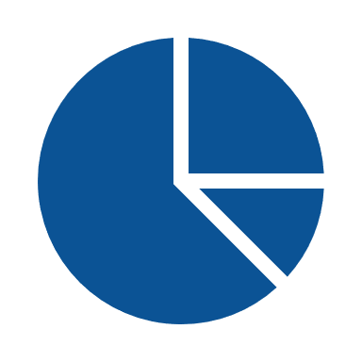

MARKET SIZE ESTIMATION
North America holds the majority of Contract Research Organization (CRO) market due to the established players in the region. Phase III segment of clinical trial acquired the highest share among all phases in 2021 as it is to authenticate the evidences produced in previous preliminary trials for safety, efficacy, and combination of drugs.
By Region
By Process Segment
By Phases
Source: ir.labcorp, iqvia, macrotrends, globenewswire, clinicalleader
Notes:
https://ir.labcorp.com/static-files/67cf4ad9-d031-4d75-a92d-667f238b4748
2018- https://ir.labcorp.com/news-releases/news-release-details/labcorp-announces-2019-fourth-quarter-and-full-year-results-and
https://s24.q4cdn.com/326377938/files/doc_financials/2020/ar/IQV-2020.12.31-10K-Final-(with-exhibits).pdf
https://www.macrotrends.net/stocks/charts/PPD/ppd/revenue
https://www.globenewswire.com/news-release/2020/02/20/1988226/34591/en/PRA-Health-Sciences-Inc-Reports-Fourth-Quarter-and-Full-Year-2019-Results-and-Provides-First-Quarter-and-Full-Year-2020-Guidance.html
https://www.clinicalleader.com/doc/surveying-the-clinical-cro-market-outsourcing-landscape-0001

Slide 7

MARKET DYNAMICS AND DEMAND-SUPPLY ANALYSIS

Slide 8
MARKET DYNAMICS AND DEMAND-SUPPLY ANALYSIS
Reduced cost, documentation, and expertise for RWD are the key drivers. However, shortage of skilled personnel and Tier 3 market penetration are the major challenges. Development of new multitasking software for digitalizing outsourcing is the latest trend in Contract Research Organization (CRO) market
Market Dynamics
Demand-Supply Analysis
1
Drivers
Reduction in cost is one of the major factors to divert outsourcing of in-house R&D activities to CROs by Pharma companies. However, enhanced productivity, access new capabilities, shifting of costings from fixed to variable, and improvements in global reachability are also essential elements
Around 10% increase in outsourcing of larger molecule development is observed. Additionally, increased outsourcing in rare diseases, specialty treatment, point of care assays, and personalized therapy & devices will also be required due to the need to submit authentic data to the relevant regulatory authorities
Pharma is noticed to collaborate with CRO to aid with predictive modeling, analytics etc. as regulators and payers place increasing importance on RWD. For ex. PPD is working to enlarge its expertise for RWD by joining forces with a division of insurance giant Anthem
Growth Rate – 10.49%
2
2
Challenges
Major challenges in CRO includes shortage of skilled personnel with knowledge and expertise in western regulatory standards such as GLP, GCP, GMP, etc. However, monitoring budget (which is around 60 percent of the trial) and the related challenges include: Number of monitors essential for the trial, travel overheads, and the patient recruitment and retention.
Securing business from Tier 3 pharmaceutical and biotechnology companies remains a hurdle
Number of Trials
Cost of Trials (billions)
Demand for clinical trials are higher in emerging countries due to the rising investment, increased number of R&D facilities in pharmaceutical and biotechnology industries to develop novel drugs, and prevalence of chronic diseases
Also, higher growth rate of clinical studies (10.49%) in comparison to the CROs (8.54%) indicates possibility for expansion of the existing CRO market, so the CRO industry is currently considered to be in the growing stage
3
Trends
A new software named Clinical Maestro is developed at Strategikon Pharma that digitalized outsourcing functions such as creating study plans and budgets, generating RFPs and is also used in comparing different proposals
Due to the lack of expertise, focus on research in developing therapeutics, and product portfolio around 60 percent of the sponsors are dependent on CROs
China, Japan, and India are estimated to witness immense growth in the market owing to high disease prevalence
Source: clinicaltrials.gov, ncbi, who,nature, sofpromed beroenic, grandviewresearch; gminsights
Notes:
https://clinicaltrials.gov/ct2/resources/trends
https://www.ncbi.nlm.nih.gov/pmc/articles/PMC7295430/#:~:text=The%20225%20individual%20clinical%20trials,US%2475%20047)%20per%20patient.
https://www.who.int/observatories/global-observatory-on-health-research-and-development/monitoring/number-of-trial-registrations-by-year-location-disease-and-phase-of-development
https://www.nature.com/articles/nrd.2017.70
https://www.ncbi.nlm.nih.gov/pmc/articles/PMC5830297/
https://www.sofpromed.com/what-is-the-cost-of-a-clinical-trial
https://www.beroeinc.com/category-intelligence/clinical-research-organizations-market/
https://www.grandviewresearch.com/press-release/global-healthcare-cro-market
https://www.gminsights.com/industry-analysis/contract-research-organization-cro-market

Slide 9

KEY SERVICE PROVIDERS

Slide 10
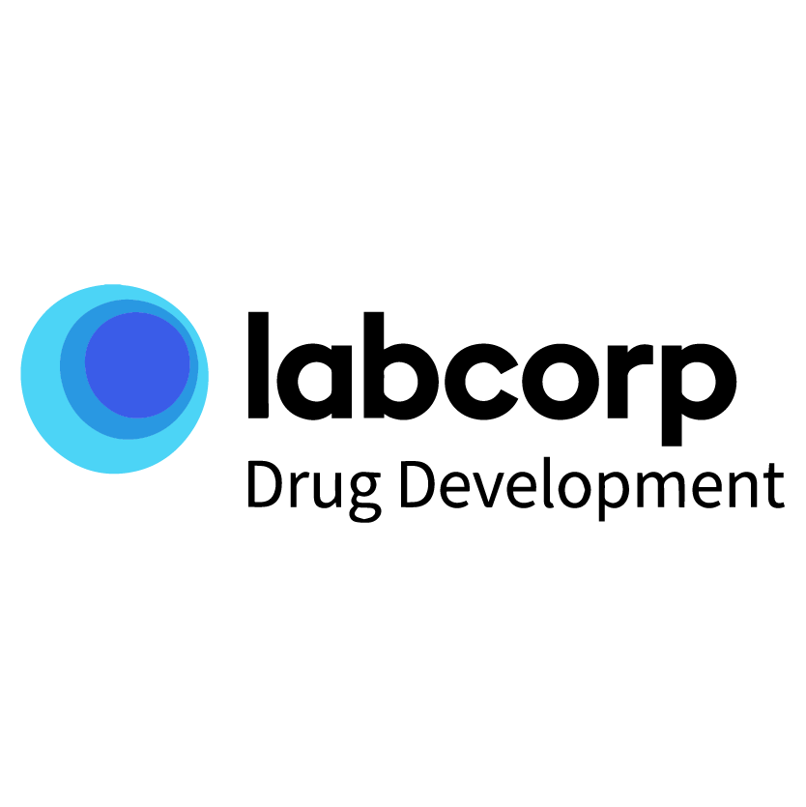
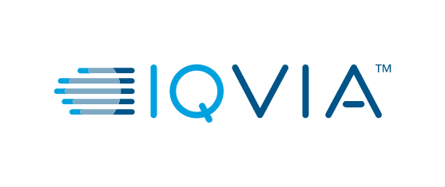






TOP THRESS KEY SERVICE PROVIDERS
Company Overview
Labcorp Drug Development is a contract research organization contributing in nonclinical, preclinical, clinical and commercialization services to pharmaceutical and biotechnology industries. Labcorp Drug Development informs to provide the world's largest central laboratory network
IQVIA, originally Quintiles and IMS Health, Inc., is a leading global provider of advanced analytics, technology solutions, and clinical research services to the life sciences industry. IQVIA is the provider for outsourcing of Phase I-IV clinical trials
Pharmaceutical Product Development is a global provider of clinical development and laboratory services, and lifecycle management services centralized on operational excellence
Business operations :
Headquarter :
Burlington, North Carolina
Durham, North Carolina
Wilmington, North Carolina
Founded :
April 1996
February 1982
January 1985
Number of employees :
70,000+
65,000
27,000+
Revenue:
$14 Billion (2020)
$11 Billion (2020)
$ 5 Billion (2020)
Source: ir.labcorp, iqvia, macrotrends
Notes:
https://ir.labcorp.com/static-files/67cf4ad9-d031-4d75-a92d-667f238b4748
2018- https://ir.labcorp.com/news-releases/news-release-details/labcorp-announces-2019-fourth-quarter-and-full-year-results-and
https://s24.q4cdn.com/326377938/files/doc_financials/2020/ar/IQV-2020.12.31-10K-Final-(with-exhibits).pdf
https://www.macrotrends.net/stocks/charts/PPD/ppd/revenue

